Slide 1
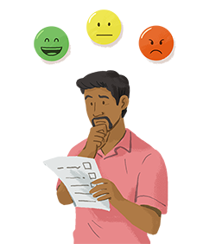
SENTIMENT ANALYSIS
Swapnali Kurhade
S.P.I.T, Mumbai

Slide 2
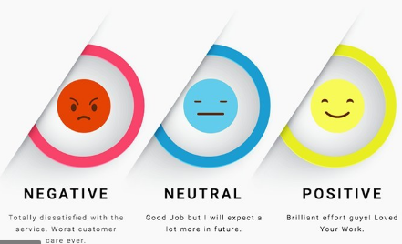
What is Sentiment Analysis?
Sentiment analysis is the process of contextually mining text to identify and categorize the subjective opinions expressed by the writers.

Slide 3
Sentiment Analysis
A basic task in sentiment analysis is classifying the polarity of a given text at the document, sentence, or feature/aspect level
i.e whether the expressed opinion in a document, a sentence or an entity feature/aspect is positive, negative, or neutral.
Advanced, "beyond polarity" sentiment classification looks, for instance, at emotional states such as "angry", "sad", and "happy".

Slide 4
Sentiment Analysis
Sentiment analysis is widely applied to voice of the customer materials such as:
reviews and survey responses,
online and social media, Twitter and Facebook.
healthcare materials for applications that range from marketing to customer service to clinical medicine.
Many topics beyond product reviews like stock markets, elections, disasters, software engineering and cyber bullying

Slide 5
Basic Steps of Sentiment Analysis:
Basic sentiment analysis of text documents follows a straightforward process:
Break each text document down into its component parts (sentences, phrases, tokens and parts of speech)
Identify each sentiment-bearing phrase and component
Assign a sentiment score to each phrase and component (-1 to +1)
Optional: Combine scores for multi-layered sentiment analysis

Slide 6
Terrible pitching | awful hitting | crushing loss
Bad pitching | mediocre hitting | close game
When you read the sentences above, your brain draws on your accumulated knowledge to identify each sentiment-bearing phrase and interpret their negativity or positivity.

Slide 7
Sentiment library
Sentiment libraries are very large collections of adjectives (good, wonderful, awful, horrible) and phrases (good game, wonderful story, awful performance, horrible show) that have been hand-scored by human coders.

Slide 8
rules-based sentiment analysis
(pitching) near (good, wonderful, spectacular)
(pitching) near (bad, horrible, awful)
A series of guidelines (“rules”) to help the computer evaluate the sentiment expressed towards a particular entity (noun or pronoun) based on its nearness to known positive and negative words (adjectives and adverbs).
The outcome is a numerical sentiment score for each phrase, usually on a scale of -1 (very negative) to +1 (very positive).

Slide 9
How negations and intensifiers affect sentiment analysis?
The bed was super comfy. The chair wasn’t bad, either.
A simple rules-based sentiment analysis system will see that comfy describes bed and give the entity in question a positive sentiment score.
But the score will be artificially low, even if it’s technically correct, because the system hasn’t considered the intensifying adverb super. When a customer likes their bed so much, the sentiment score should reflect that intensity.

Slide 10
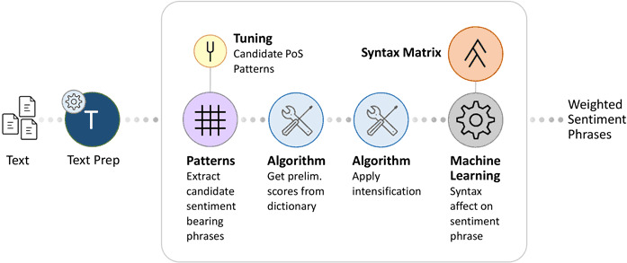
Hybrid Sentiment Analysis Systems

Slide 11
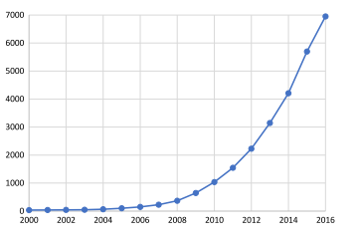
Year wise publications (Scopus)

Slide 12
Data Analysis Techniques
Techniques are divided into three sub-classes.
Machine Learning:
PCA,
Bayesian,
Self Organizing Maps,
Ensemble learning,
knn,
graphbased,
fuzzy logic,
crfs (conditional random fields).

Slide 13
Data Analysis Techniques
Natural Language Processing (NLP):
Ngram (to be, be or, or not ...)
(word) embedding,
bigram,
stop word,
parser,
Morphological (The study of words, how they are formed, and their relationship to other words in the same language)
Sentiment Analysis:
subjectivity,
negation,
dictionaries,
emoticons,
tone,
stance,
wordnet

Slide 14
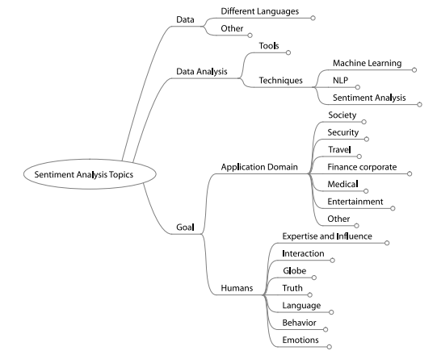
Various domains: work done

Slide 15
Deep Learning
With the recent advances in deep learning, the ability of algorithms to analyse text has improved considerably.

Slide 16
References
Mika V. Mäntylä , Daniel Graziotin , Miikka Kuutila, ”The evolution of sentiment analysis—A review of research topics, venues, and top cited papers”. Elsevier
https://www.lexalytics.com/technology/sentiment-analysis

